Slide 1
Climate Change around the World
​ Photo created with The GDELT Project
Alison Garrett
Unsolicited Report to the UN
12 November 2021

Slide 2

COP26 United Nations Climate Change Conference
In 2015 world leaders came together at the COP21 UN Climate Change Conference in Paris France
From this conference came the Paris Agreement, also known as the Paris Accord and Paris Climate Accord
196 parties signed on to set goals to minimize the rise in global temperature as well as emissions reductions
COP26, being held in Glasgow Scotland,
comes as expected results have not been
achieved and commitments are wavering

Slide 3

Understanding World Opinion
The UN is interested in world opinions about this shared challenge
This quick look report scopes the challenges in and commitment to resolving climate
change issues by analyzing the worldwide COP26 news headlines
​ Photo courtesy COP26

Slide 4
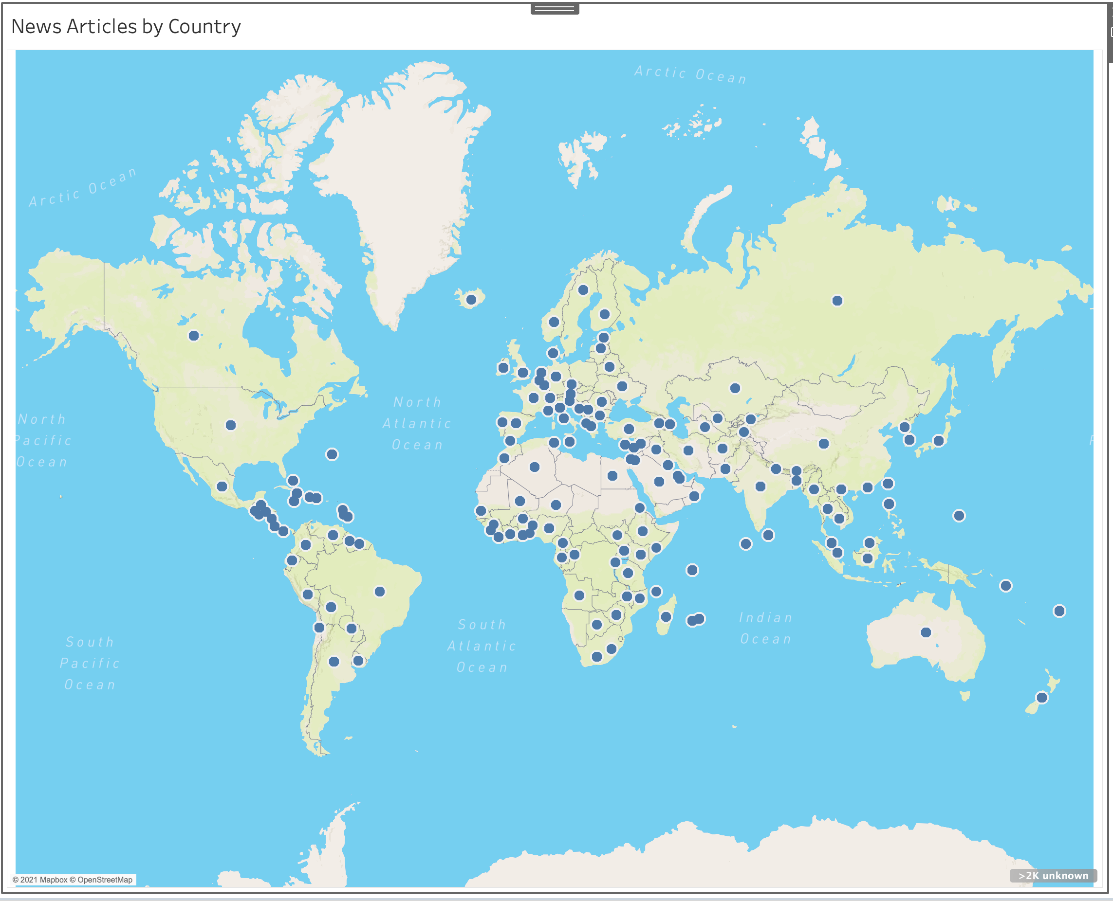
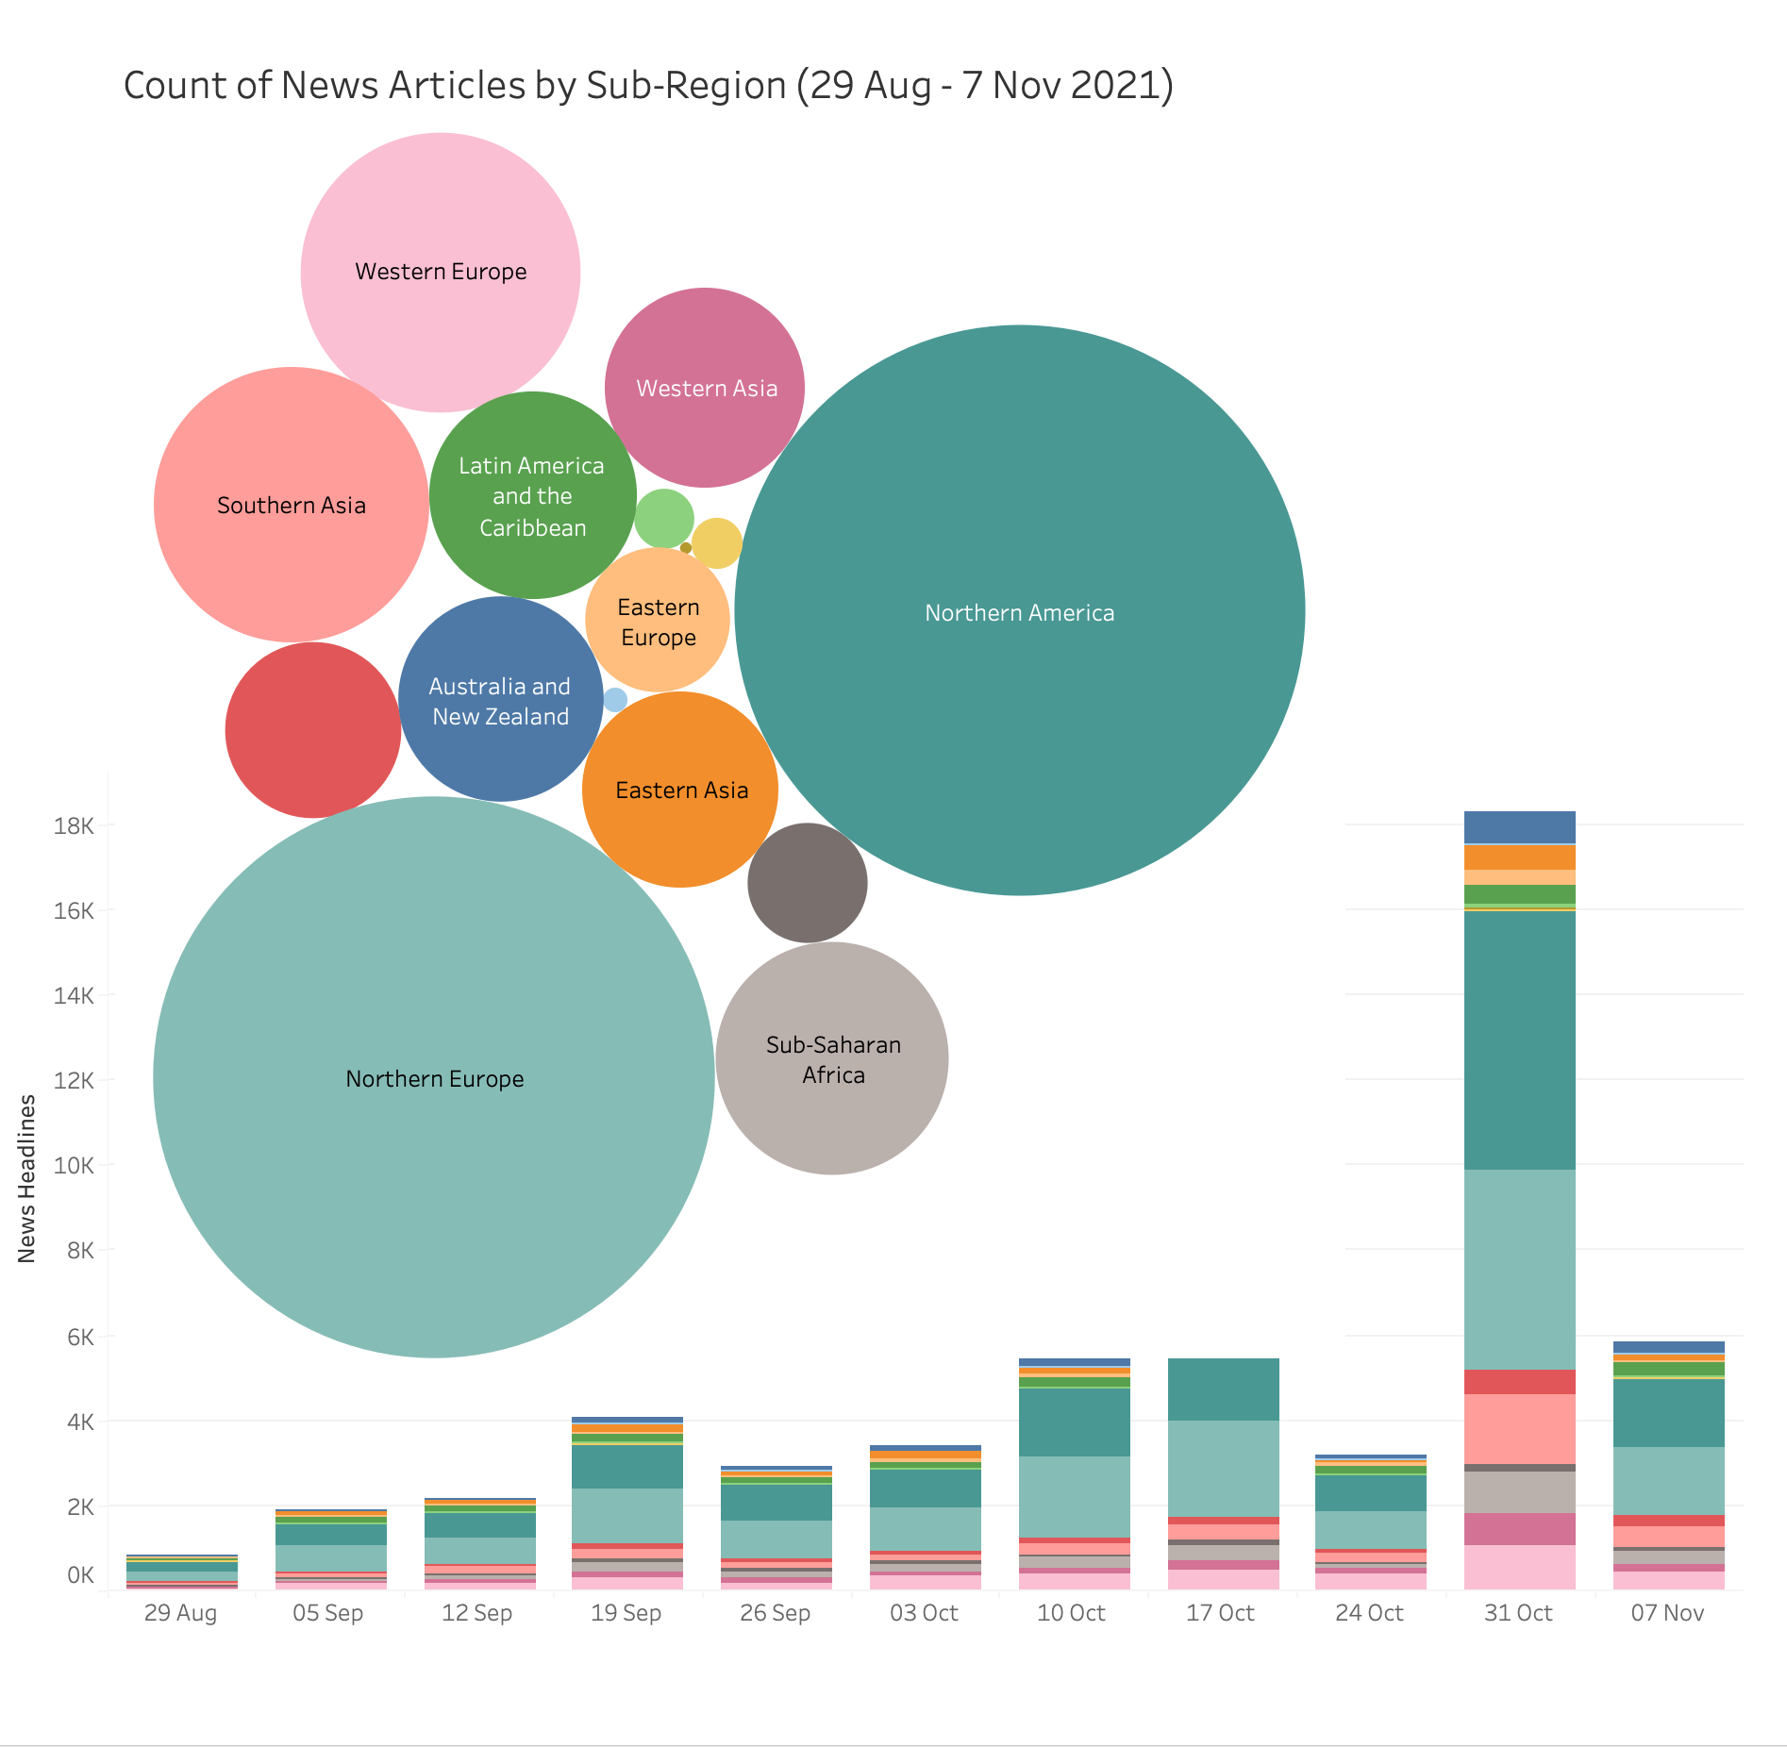
The GDELT Project: Worldwide News Feed
173 Countries
55,243 News Headlines
​ Data from The GDELT Project

Slide 5
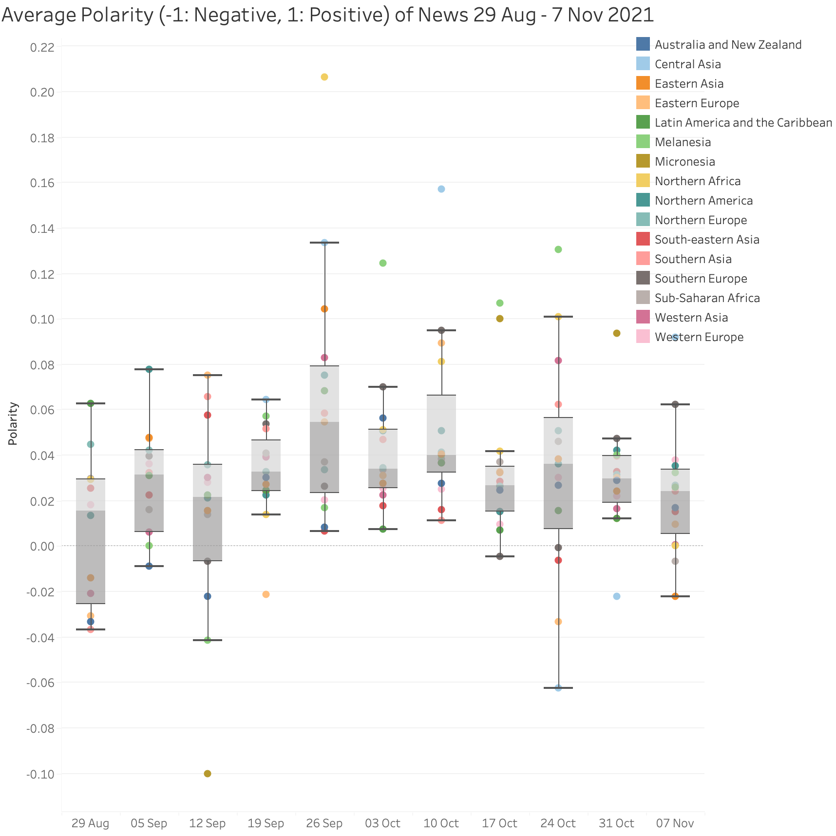
Headlines More Positive
Relatively consistent view on COP26 leading up to the conference and for week 1
Asia, Northern Africa trend more positive
Eastern Europe, Australia/New Zealand trend more negative
Point source exceptions for sensational news

Slide 6
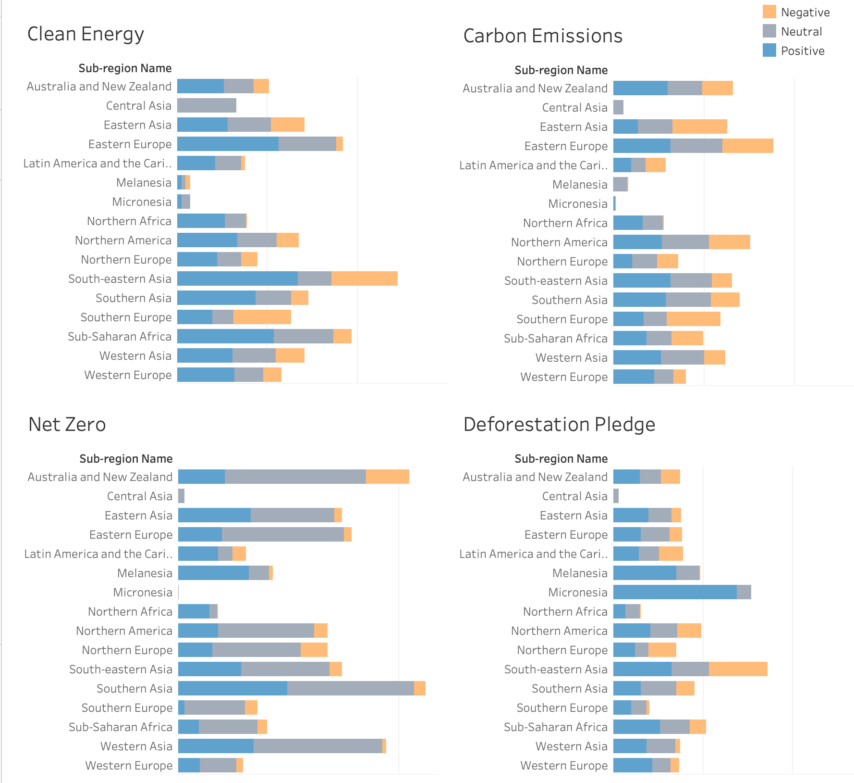
Regional Topics
Southeastern Asia positive on Clean Energy
Eastern Europe / Asia more negative on Carbon Emissions
Favorable support for Net Zero topics
All around positive support for Deforestation Pledge

Slide 7
Next Steps
Collect final, post-conference news articles
Improve translation
Consider clustering to identify deeper trends
Finalize report to support world outreach

Slide 8
Back up

Slide 9
Algorithms / Tools
Beautiful Soup / Selenium
Excel Data Cleaning
Textblob
Sentiment
NMF / CorEx
Models
Headline
Source
Country
Language
Common
Terms
World
Leaders
Polarity
Subjectivity
Anchor
Topics
The GDELT
Project
Multi-language
News
Headlines
Tableau
Visualization
Select
News
Punctuation
Lowercase
Stopwords
Tokens
No
Stopwords
English
GDELT API
Google
Translator
RegEx
Cleaning
TfidfVectorizer

Slide 10
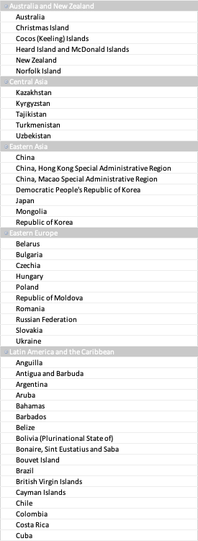
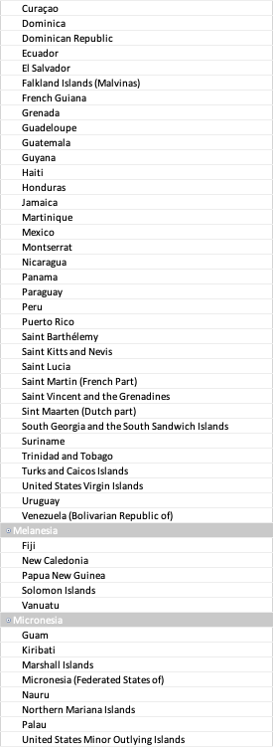
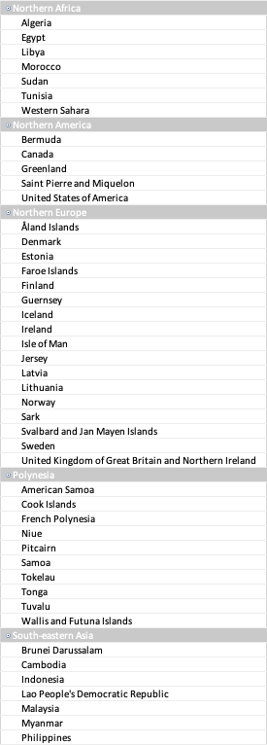
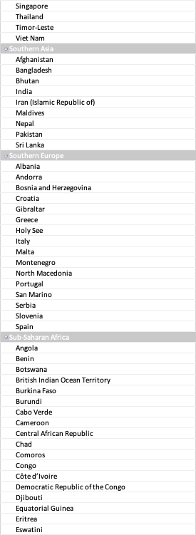
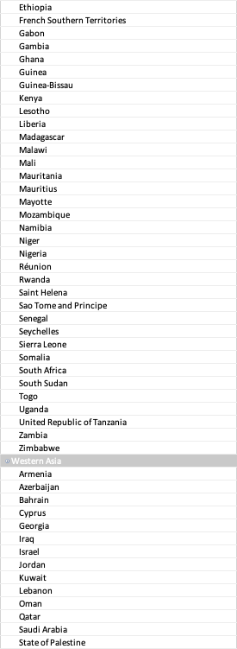
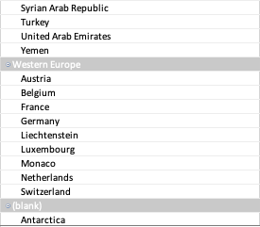
UN Countries / Sub-Regions
Data from UN Countries / Sub-regions

